Slide 1

River Flow Analysis
By Scott Burstein

Slide 2

Objectives
Outline steps I took to complete coding challenge.
Share findings and contextualize results.
What I learned and what I am working towards.
Notes:
This is a brief summary of my work for the climate AI coding challenge

Slide 3
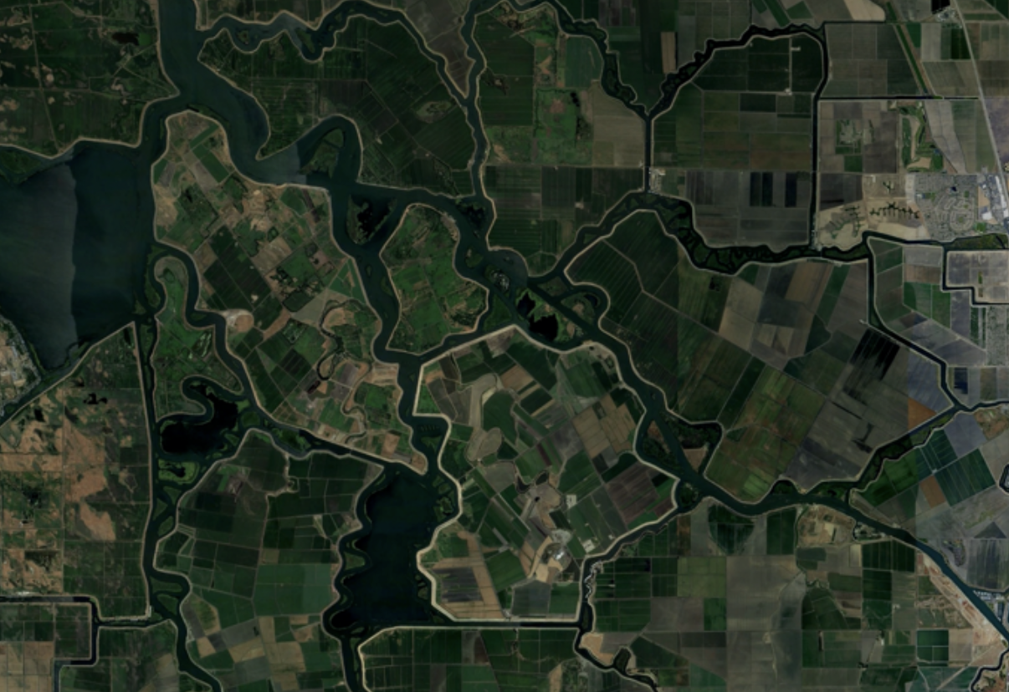
Structure of Analysis
Data Cleaning and Preparation (in R)
Summary Statistics and Data Transformation
Regression Analysis
Train ML Model
Future Steps:
Test Model
Apply to Client’s Production Scenario

Slide 4
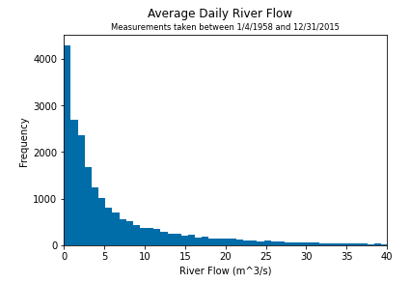
Summary Statistics
Important metrics for each variable:
Median, Interquartile Range
Outliers (min/max)
Count (should all be the same)
Data Types
Example histogram of daily river flow frequency
Notes:
Visualizations like this help us get a cursory understanding of the given data.
(EXPLAIN VIZ)
It’s also important to look at metrics like the median and IQR for each variable,
Check for outliers,
And make sure that all data is represented in an appropriate format.

Slide 5
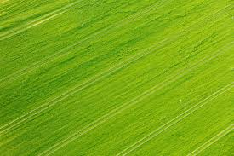

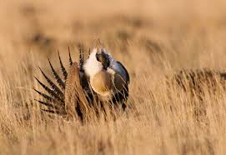

The Challenge
Predict daily river flow from 9 surrounding temperature and precipitation measurement stations.
Potential applications include:
Downstream agriculture ventures
Water reservoirs
Habitat restoration / Conservation efforts
Academic research

Slide 6
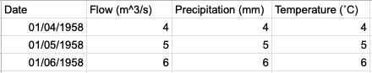
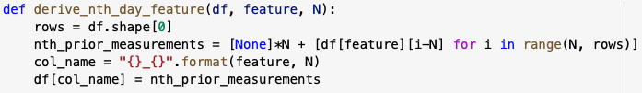
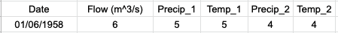
Data Cleaning
Used R to un-pickle the data, rename variables and merge the two datasets.
Derived precipitation and temperature values corresponding to N days prior for each date (row):
Function to create new columns:
Notes:
I used R to unpack and merge the Flow and observational datasets
And I then exported the cleaned data file to Python for the remainder of my analysis
In order to run a supervised machine learning model, it is important to construct a dataframe where all input variables are associated with the output variable. In this example, each row of data must contain a flow value as well as the predictor variables. I used a function to do this. This also allows my code to be reproduced for different uses, where let's say we wanted to use data from the 10 previous days instead of only 3.

Slide 7
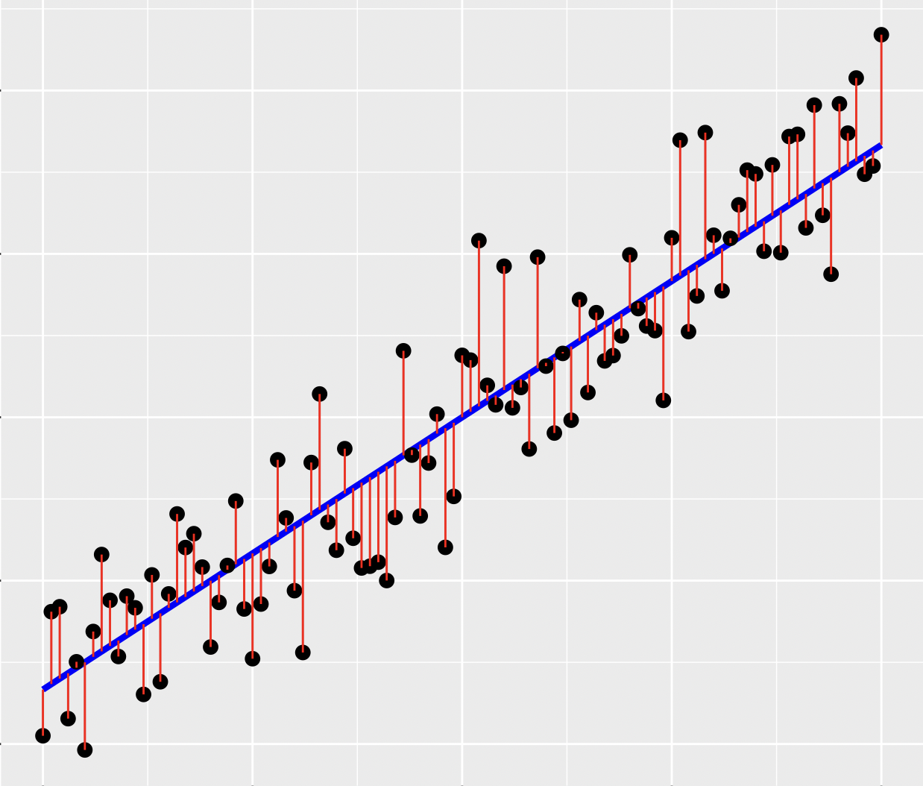
Linear Regression Model
Select relevant independent variables.
For each river flow forecast, there are 27 precipitation and 27 temperature predictor variables.
Assess Pearson correlation coefficients.
All 54 correlation coefficients have range [0.19 - 0.36]
Notes:
“Linear regression aims to apply a set of assumptions primary regarding linear relationships and numerical techniques to predict an outcome based off of one or more predictors.”
There are 27 because in this model we will be using data from 9 locations for the 3 days preceding the flow prediction.
These correlation coefficients all imply a moderately strong, positive relationship between the 54 predictor variables and river flow forecast. Since the range is fairly small, there is no reason to remove any predictor variables from the model.

Slide 8
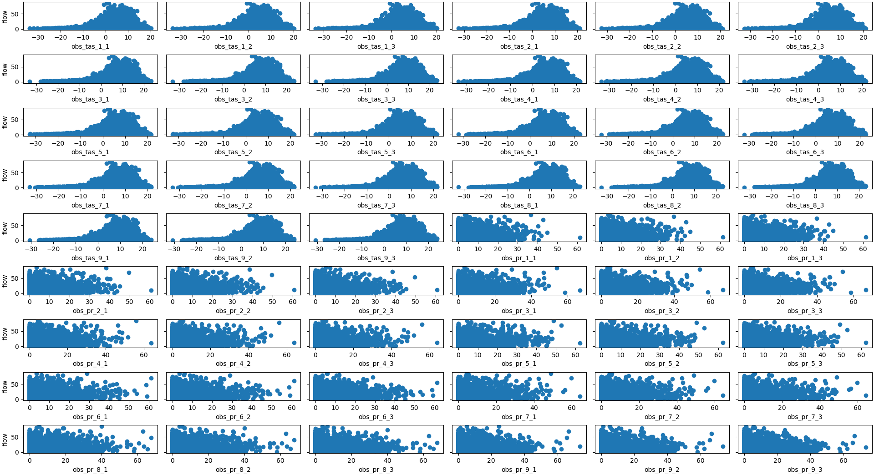
Linear Regression (cont.)
Predictor Variable Relationships with Response Flow Variable
Notes:
We can now see in the simplest of ways that all 27 temperature predictors have similar relationships with the response variable,
and all 27 precipitation predictors have similar relationships with the response variable.
While this does not help us quantify these relationships, it does allow us to conclude that all 54 predictor variables are necessary to move forward with in our analysis.
For example, if one of these scatterplots looked drastically different than the others, perhaps it would indicate that different sensor values should carry different weights in our model, or not be included at all.

Slide 9
Training a ML Model
Using supervised machine learning methods to create a DNNRegressor:
More data cleaning!
Split data into (80%) training set, (10%) testing set, and (10%) validation set.
Instantiate neural network with 2 hidden layers.
Define reusable function to manage data input.
Export model.
Explained Variance: 0.38 Mean Absolute Error: 4.59 m^3/s flow Median Absolute Error: 2.41 m^3/s flow
Notes:
Training a supervised ML model next involved cleaning and splitting the data into independent training, testing and validation sets, creating a neural network using Scikit-learn and TensorFlow, and exporting the model.
Now, the explained variance of 0.38 and absolute error values indicates that perhaps the model does not accurately fit the data.
Other ML weather applications may look for an explained variance closer to 0.8 or 0.9.
Also, the mean and median absolute errors are fairly large given the range of flow values.
This brings us to an important discussion of potential error.

Slide 10
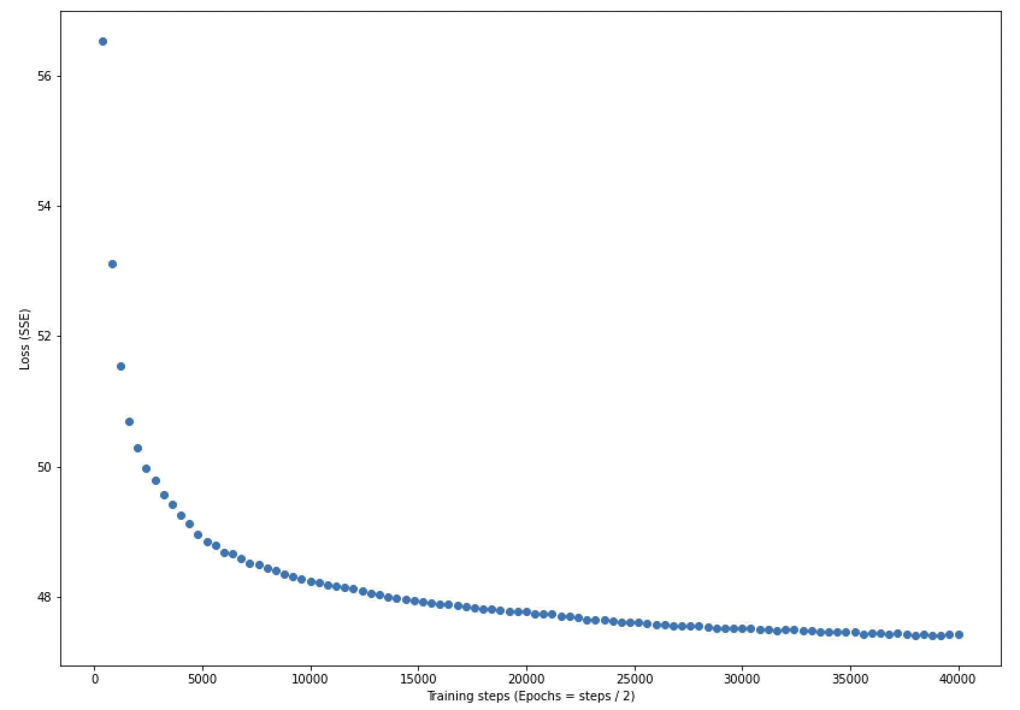
Sources of Error
Loss SSE vs. Training Steps Plot
Bias?
Variance?
Indicates that the model was not overfitted since the evaluation losses never exhibit a significant change in direction toward an increasing value.
Notes:
Now, the sum of squared error plot indicates that…….
Other sources of error could be attributed to
-Bias which would imply that our model is not complex enough to capture the underlying relationships among the data
-And on the other hand Variance, which can be caused by a model that pays too much attention to the training data and does not generalize well or overfits the training data.

Slide 11
Future Steps
Create a more robust linear regression model.
Extract tensors from TensorFlow object.
Back-test data to assess model efficacy.
Deliver usable product to client.
Receive feedback.
Notes:
Given the circumstances of the challenge, these are the steps I took. If given more time or in a real client-facing production scenario, I would want to…..
1.
2. Extract tensors into a more easily understood model
3. Back-test data to assess prediction accuracy
4. And of course deliver the final product to relevant parties and get feedback.

Slide 12

What I am working towards:
Gain more hands-on ML experience
Develop stronger foundation in regression analysis
Complete Codecademy data science path / other online courses
Specialize in climate analytics / environmental data science applications
Notes:
All things I hope to accomplish or work on THIS SEMESTER
Through DAML and Repass-Rodgers Program
Through statistics course I am currently enrolled in
Related to data science and machine learning
Learn more about industry specific insights and methods, as this is ultimately the field of work I want to pursue professionally.

Slide 13
Thank You!
Questions?

